Slide 1

CompareNet: Reproduction of Graph Neural Fake News Detection with External Knowledge
Team members:
Zhuocheng Guo,
Yipeng Liu,
Zhiyun Richard Peng

Slide 2
Contents:
1- Problem Statement
2- Data
3- Approach
4- Result and Analysis
5- Conclusion

Slide 3
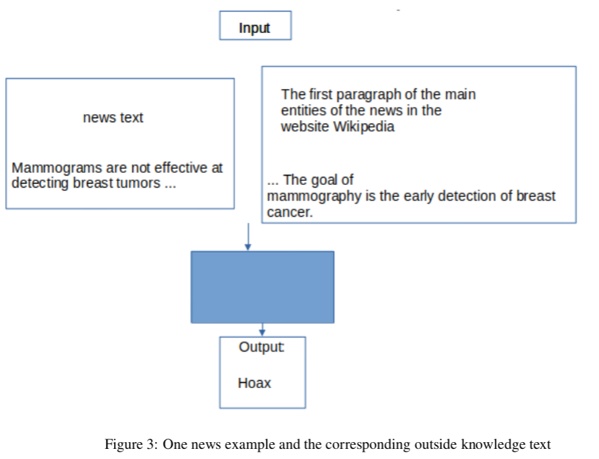
Problem Statement
Fake news detection, which aims to verify whether a news document is trusted or fake.
We reproduce a state-of-the-art fake news detection approach in Hu et al. (2021), and compare its performance with the basic baseline method LSTM in this article.
~450 words
We could learn a lot from this project, such as the idea of fake news detection ,and an ingenious model design.

Slide 4
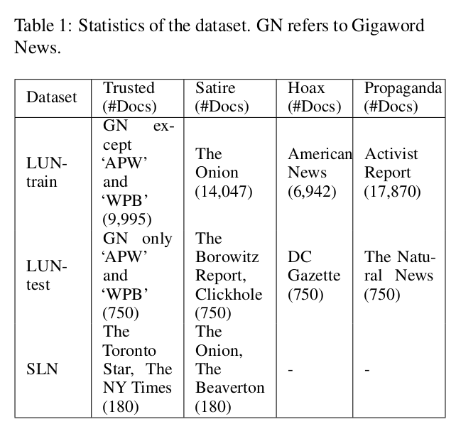
Data
SLN: Satirical and Legitimate News Database.
LUN: Labeled Unreliable News Dataset.
Eg. input: “Mammo-grams are not effective at detecting breast tumors...”
Output: Hoax
Size of the dataset: around 50,000, containing four different classes or two different classes.
The average length of news: around 450 words.

Slide 5
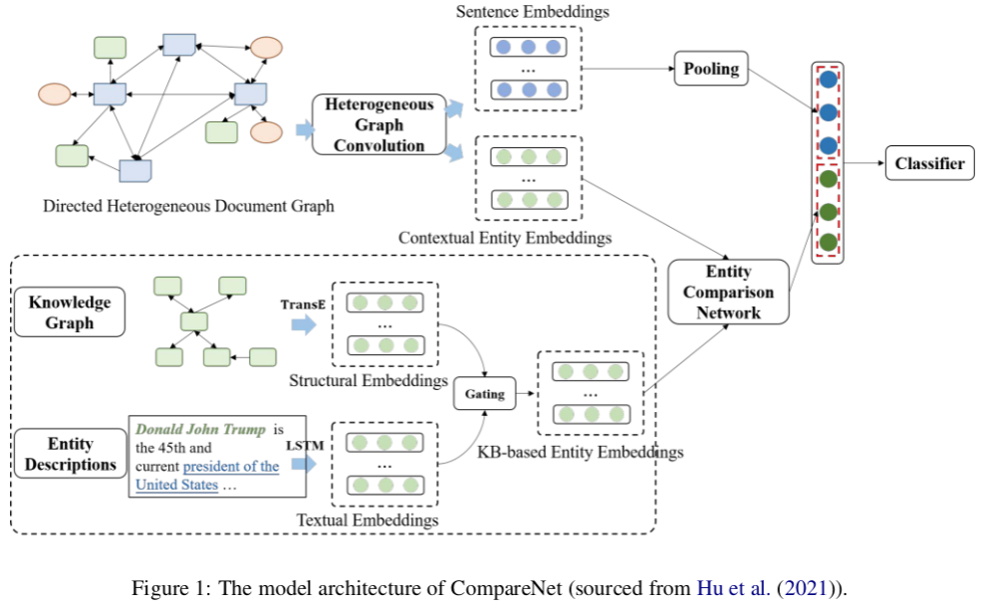
Approach: CompareNet
We re-implement the CompareNet which framework is shown in Fig. 1

Slide 6



Approach: CompareNet
We re-implement the CompareNet whose framework is shown in Fig. 1
There are mainly three parts.
The first part is the directed hetero-
geneous document graph.
sentences
topics
entities

Slide 7

Approach: CompareNet
We re-implement the CompareNet whose framework is shown in Fig. 1
The second part is the heterogeneous graph attention network.
the (l + 1)-th layer representation of the nodes

Slide 8
Approach: CompareNet
We re-implement the CompareNet whose framework is shown in Fig. 1
The third part of CompareNet is the entity com-parison network.
It generates KB-based entity embeddings.

Slide 9

Approach: CompareNet
we re-implement the CompareNet whose framework is shown in Fig. 1
The fourth part is final topic-enriched news document embedding H_d will concatenate with the comparison feature vector C as output from the entity comparison network.

Slide 10

Approach: Bidirectional LSTM network
h_t is a hidden state at time step t
Tokenize all the words in dataset by
GloVe tokenizer.
Initialize word embeddings for each word in the document by pre-trained word embeddings – GloVe.
Push through LSTM encoder
A max pooling layer.
A fully connected layer, to get the final label prediction.

Slide 11
Evaluation metrics
Micro-averaged (Precision = Recall = F1) and
Macro-averaged scores (Precision, Recall, F1)
global average
arithmetic mean

Slide 12
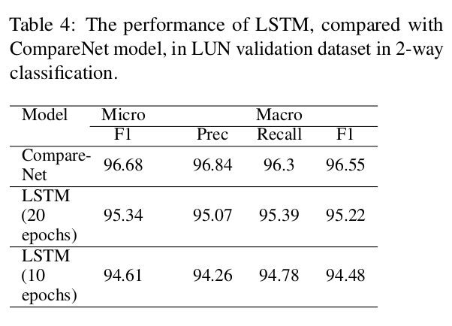
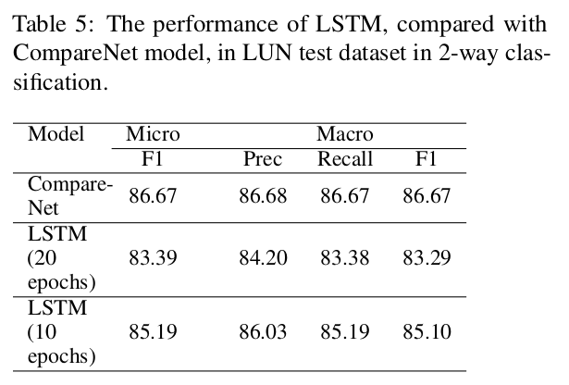
Experiment results
The Micro F1 of CompareNet is only 2.2% higher than the counterpart of LSTM (10 epochs) model.
Dataset are not very suitable.

Slide 13
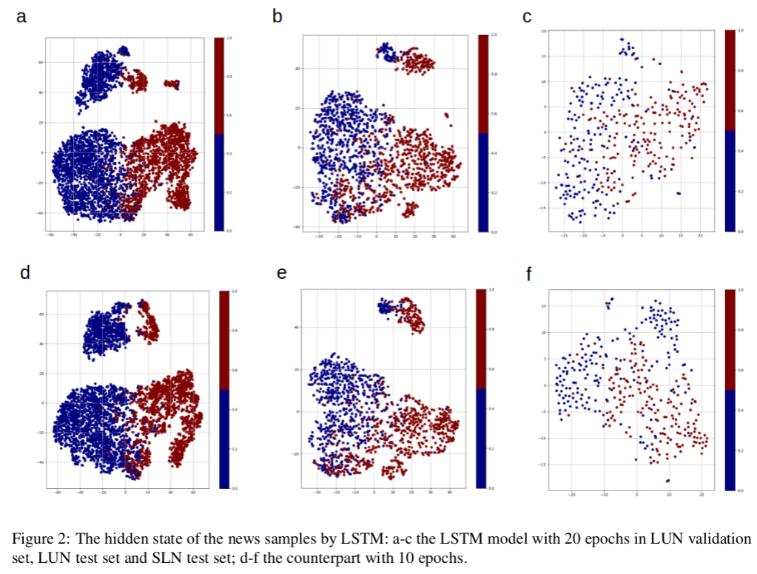
Experiment results
Blue point means the ground truth of the sample is ``satirical", and red point ``trusted".
LSTM can clearly divide the features of samples in the LUN validation set and LUN test set, but not in SLN test set.

Slide 14
Qualitative example
The entity ``Mamograms" is recognized in the news text,
And is used to retrieve the knowledge in Wikipedia to help increase the accuracy of fake news detection,
And generate the correct class: ``Hoax".

Slide 15
Conclusion
Reference
Reproduced the results of the proposed model in ref. Hu et al. (2021), and verified the validity of their results.
In LUN validation dataset and LUN test dataset, the proposed method only has small margin over LSTM, which means these two datasets are not suitable for demonstrating the advantages of CompareNet.
Linmei Hu, et al. 2021. Compare to the knowledge: Graph neural fake news detection with external knowledge. In Proceedings of the 59th Annual Meeting of the Association for Computational Linguistics and the 11th International Joint Conference on Natural Language Processing (Volume 1: Long Papers), pages 754–763.

Slide 16
Thank you

